Slide 1


Performance metrics overview
Session No.: 04
Course Name: Machine Learning
Course Code: R1UC525B
Instructor Name: Dr. Sivakumar Madeshwaran
Duration: 50 Minutes
Date of Conduction of Class: 14-08-2026

Slide 2

Recap
Applications of ML Life Cycle:
ML is used in healthcare (diagnosis, drug discovery), finance (fraud detection), retail (recommendation systems), and manufacturing (predictive maintenance).
Core phases: Data Collection → Preprocessing → Model Building → Evaluation → Deployment & Monitoring.
Continuous improvement through feedback and retraining is essential.
History of ML:
1950s: Early concepts (Turing Test, Checkers-playing program by Arthur Samuel).
1958: Perceptron introduced by Frank Rosenblatt.
1980s–1990s: Rise of neural networks, decision trees, and SVMs.
2010s: Deep learning revolution (AlexNet, GPT, transformers).

Slide 3
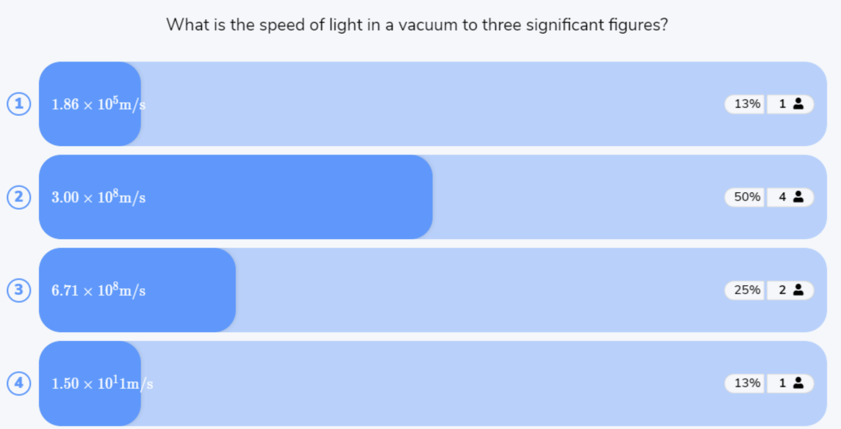
Reflect on the responses of post session activity

Slide 4




“How can we know whether a Machine Learning model is performing well?”
Opening Question

Slide 5
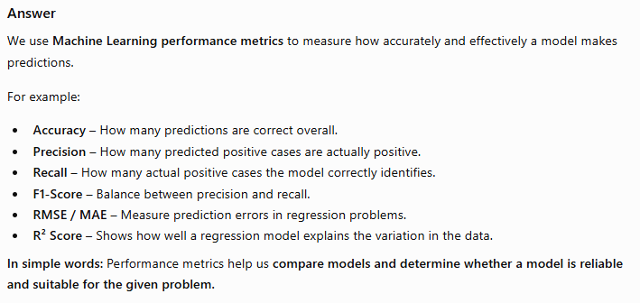
Opening Question -Reflections

Slide 6
At the end of this session students will be able to
LO1: Explain the importance of performance metrics in evaluating machine learning models
LO2: Compute and interpret key metrics (MAE, MSE, R², Accuracy, Precision, Recall, F1) using real dataset examples

Slide 7
Session Outline
1 Introduction to Performance Metrics and its types
2 Activity-1
3 Key Formulas and Concept (MAE, MSE,
R², Accuracy, Precision, Recall, F1)
5 Activity-2 (Quiz on Wooflash)
6 Review and Reflections
4 Applications and Visual tools

Slide 8
Performance metrics overview
Performance metrics are numerical measures used to answer one important question:
“How well is my Machine Learning model performing?”
For example, if a model predicts whether a patient has a disease, we need to measure whether its predictions are correct.
Key Points
Quantitative measures
  Performance metrics give us numbers to evaluate a model.
  Example: Accuracy = 95% means the model correctly predicts 95 out of 100 cases.
Measure unseen-data performance
  A good model should perform well not only on training data but also on new/unseen data.
Help in model selection
  Metrics allow us to compare different models.
  For example, if Model A has 90% accuracy and Model B has 96%, Model B may be better—depending on the problem and other metrics.
Help to improve the model
  Metrics shows where a model is making mistakes.
  We can then change the algorithm, features, or parameters to improve performance.

Slide 9
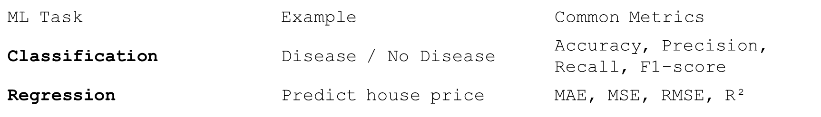
Performance metrics overview
Classification vs. Regression
The metric depends on the type of ML problem:
Medical Example
Suppose an ML model predicts whether a patient has a disease.
There are two important types of mistakes:
False Positive: Model says disease, but the patient is actually healthy.
False Negative: Model says healthy, but the patient actually has the disease.
In medical applications, missing a real disease (False Negative) can be much more serious than giving a false alarm. Therefore, accuracy alone may not be sufficient; metrics such as Recall, Precision, and F1-score become important.

Slide 10
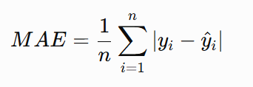
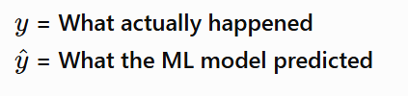
Common performance metrics used for regression models
1. Mean Absolute Error (MAE)
Formula:
Measures the average absolute difference between actual and predicted values.
Lower MAE = better model.
It is easy to understand because it uses the same units as the target.
Example:
Actual house price = ₹50 lakh
Predicted price = ₹48 lakh
Error = ₹2 lakh.
If the average error is ₹2 lakh, then MAE = ₹2 lakh.
Think: “On average, how far is my prediction from the actual value?”

Slide 11


Common performance metrics used for regression models
2. Mean Squared Error (MSE)
Formula:
Calculates the errors and squares them.
Large errors receive a much higher penalty.
Lower MSE = better model.
Example:
Errors = 2, 3, 10
Squared errors:
The error of 10 becomes 100, so MSE strongly penalizes large mistakes.
Think: “Are there any very large prediction errors?”

Slide 12
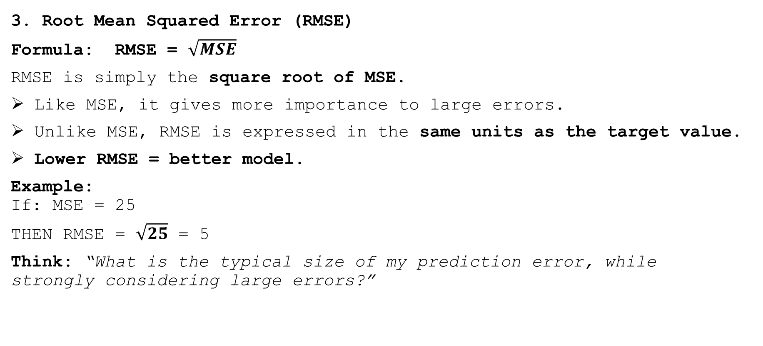
Common performance metrics used for regression models
3. Root Mean Squared Error (RMSE)
Formula: RMSE = $\sqrt{MSE}$
RMSE is simply the square root of MSE.
Like MSE, it gives more importance to large errors.
Unlike MSE, RMSE is expressed in the same units as the target value.
Lower RMSE = better model.
Example:
If: MSE = 25
THEN RMSE = $\sqrt{25}$ = 5
Think: “What is the typical size of my prediction error, while strongly considering large errors?”

Slide 13
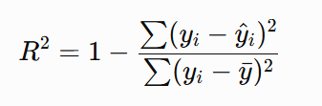
Common performance metrics used for regression models
4. R-Squared (R²)
Formula:
R² tells us how much of the variation in the target variable is explained by the model.
For Example:
R² = 1.0 → Perfect prediction
R² = 0.90 → Model explains 90% of the variation
R² = 0.50 → Model explains 50% of the variation
R² = 0 → No improvement over simply predicting the mean
Think: “How well does my model explain the data?”

Slide 14
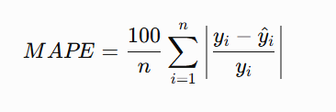

Common performance metrics used for regression models
5. Mean Absolute Percentage Error (MAPE)
MAPE tells us the average prediction error as a percentage.
Formula
Here:
yi​ = actual value
​ = predicted value
n = number of observations

Slide 15
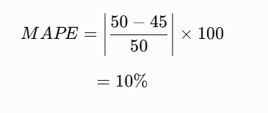
Common performance metrics used for regression models
Simple Example
Suppose the actual house price is ₹50 lakh and the predicted price is ₹45 lakh.
So, the prediction has a 10% error.
Remember:
MAPE = “On average, how many percent wrong are my predictions?”
Lower MAPE = better model.
Important: MAPE becomes problematic when the actual value y​_{i} is zero or very close to zero, because we divide by y​_{i}​.

Slide 16

Common performance metrics used for regression models
6. Pearson Correlation Coefficient (r)
Pearson's r measures the strength and direction of the linear relationship between the actual values and predicted values.
It tells us whether the predictions move in the same direction as the actual values.
Value of r
r value | Meaning
+1 | Perfect positive relationship
0 | No linear relationship
−1 | Perfect negative relationship

Slide 17
Common performance metrics used for regression models
Simple Example
Suppose actual values increase:
10 → 20 → 30 → 40
and predictions also increase:
11 → 19 → 31 → 39
The predictions follow the same pattern as the actual values, so r will be close to +1.
Important Difference
Pearson r is not exactly the same as R².
R² → How much variation is explained by the model.
r → How strongly actual and predicted values are linearly related.
Remember:
Pearson r = “Do my predictions follow the same pattern as the actual values?”

Slide 18
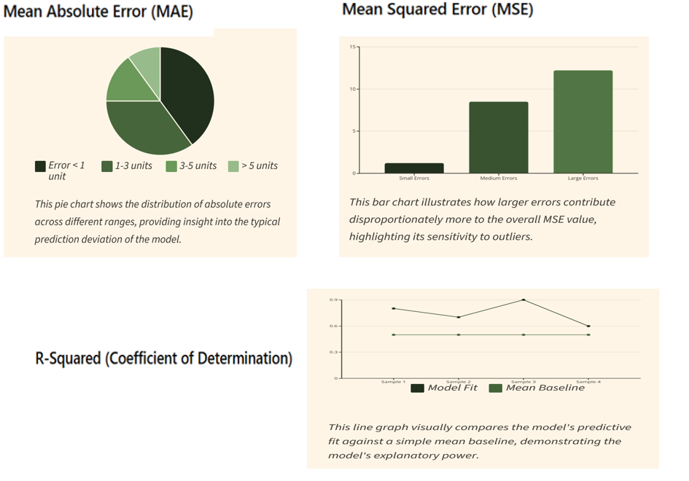

Slide 19
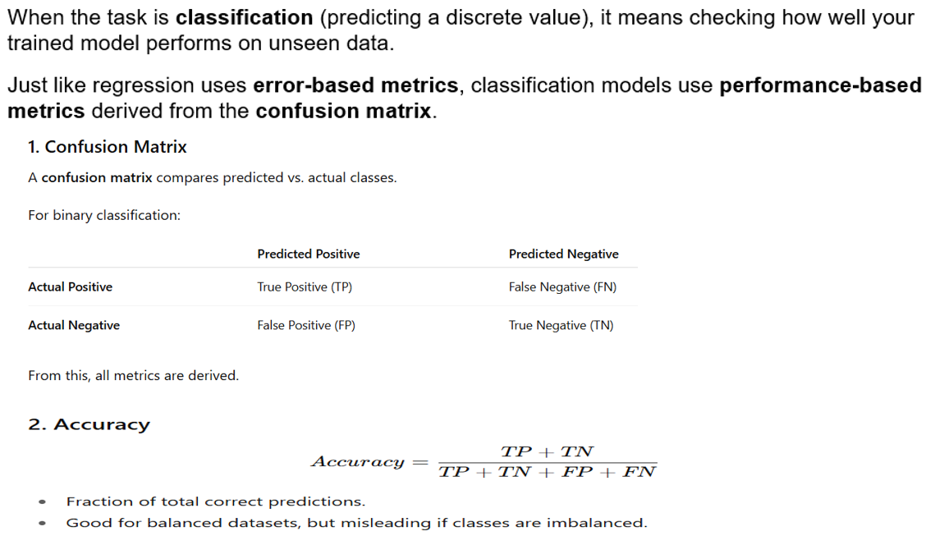

Slide 20
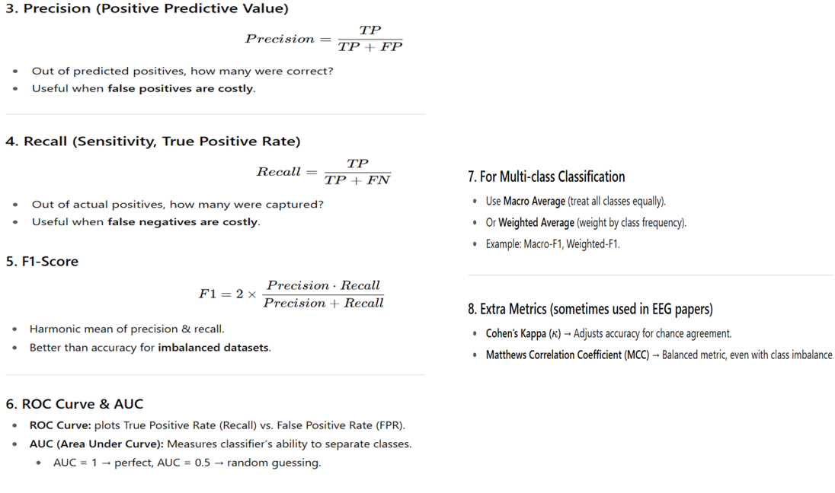
ROC → Receiver Operating Characteristic.

Slide 21
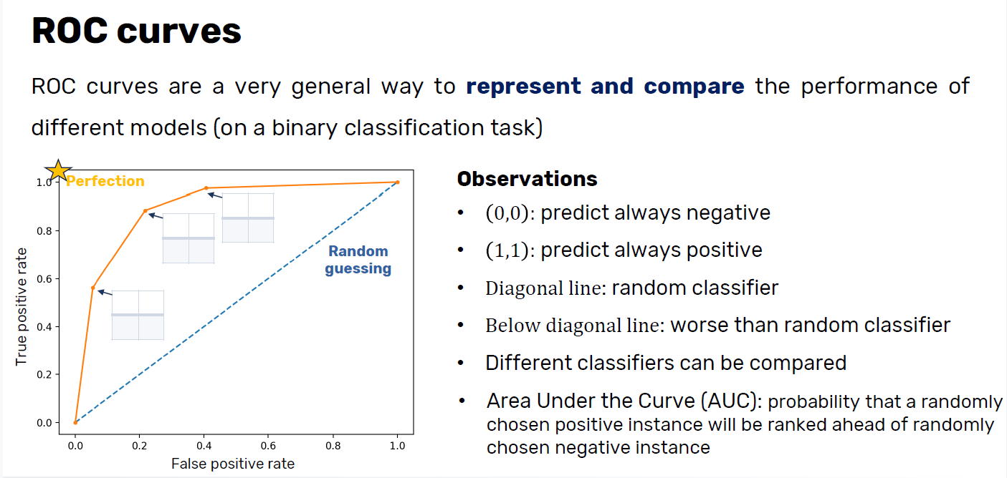

Slide 22
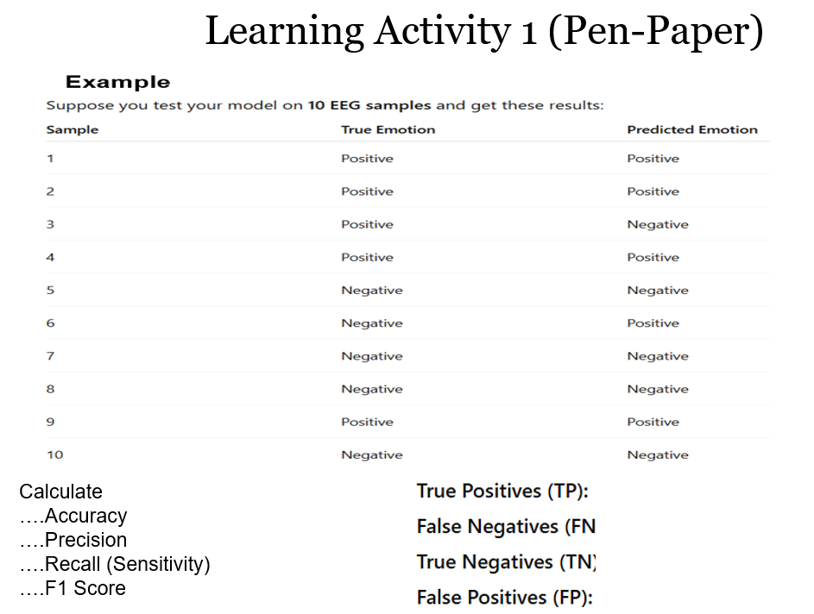

Slide 23
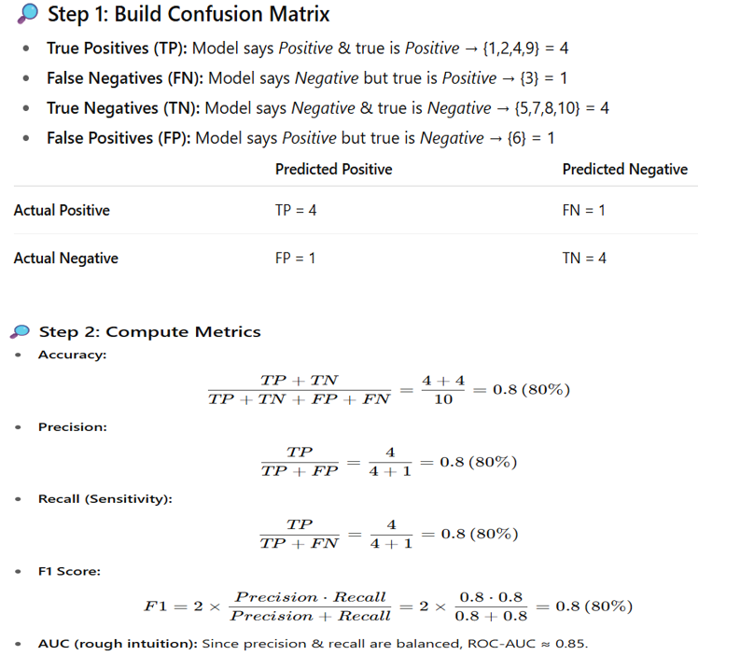

Slide 24
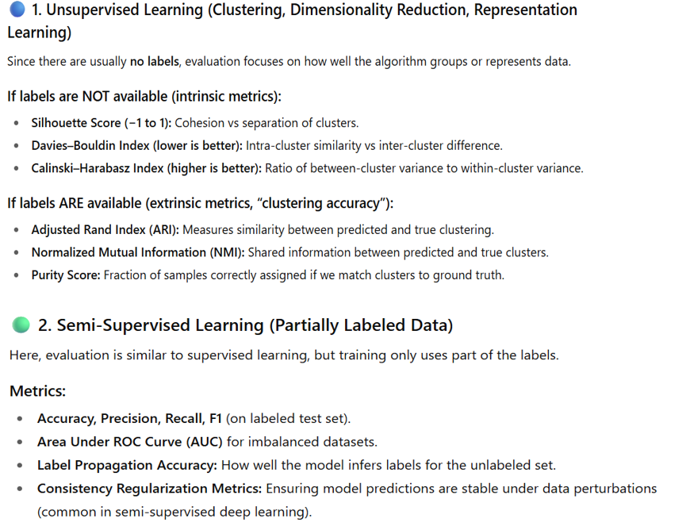

Slide 25
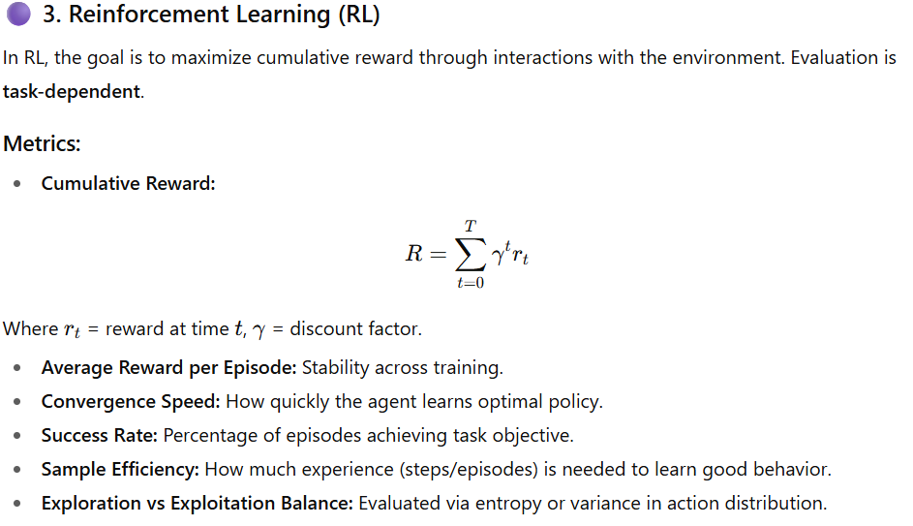

Slide 26
Activity 2: Think -Pair -Share
Accuracy vs. F1 (Classification)
Think: “Is Accuracy always the best metric for classification? Why or why not?”
Pair: With a partner, discuss a case where Accuracy is misleading (e.g., imbalanced EEG dataset with 90% Neutral emotions).
Share: Groups present why F1-score or ROC-AUC would be better.

Slide 27
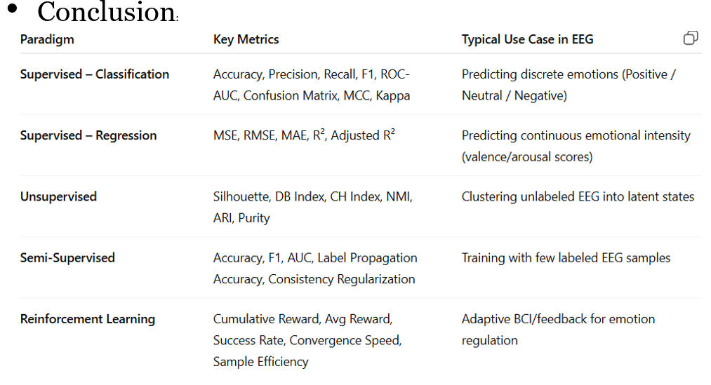
Summary

Slide 28
Ensure attainment of LOs in alignment to the learning activities: outcomes (1-2)
LO1: Explain the importance of performance metrics in evaluating machine learning models
LO2: Compute and interpret key metrics (MAE, MSE, R², Accuracy, Precision, Recall, F1) using real dataset examples

Slide 29

Post Session Activity

Slide 30
Information about the next lesson
Machine Learning Approaches overview (Regression, Classification, Clustering, Reinforcement Learning, Genetic Algorithm), Issues in Machine Learning

Slide 31


Review and Reflection from students

